Slide 1


Slide 2
Background

Slide 3


Introducing the Valkey project
Fully compatible with Redis OSS 7.2
Vendor Neutral
BSD-3 Licensed
Built by contributors in the open source community
Notes:
Three key points about Valkey:
1. It’s fully compatible with Redis OSS 7.2, and will always be.
2. It’s backed by the linux foundation, so it will remain open-source and vendor neutral.
3. It has a diverse backing. There are six technical steering members, from six different companies.

Slide 4












Backed by industry leaders

Slide 5
The Valkey project is thriving
50+ corporate supporters of the project
225+ code contributors to Valkey engine
60+ code contributors to clients and supporting libraries
1500+ pull requests across all projects since launch
100M+ container pulls
10+ managed Valkey providers
Notes:
Valkey is a thriving project, highlight the corporate support, number of commits, and how it's being widely adopted.
Limited managed provider list: AWS, Aiven, GCP, Elastio, OCI, Yandex, Upcloud, Netapp instaclustr, Percona, Exoscale, stackhero

Slide 6
Latest developments in Valkey OSS
September 16
2024
October 21
2025
Valkey 8.0
Release
Valkey 8.1
Release
Valkey 9.0
Release
April 2
2025
Notes:
Valkey's releases have been on a roughly 6 month cadence. Valkey 9.0 shipped in October 2025 and 9.1 shipped in May 2026.
Valkey 9.0 was a major release with atomic slot migration, hash field expiration, numbered databases in cluster mode, and 1 billion+ RPS clusters.

Slide 7
Feature Deep Dive

Slide 8
Valkey 7.2 (April 2024)
First stable Valkey release, forked from Redis 7.2
100% API compatible with Redis OSS 7.2
Community governance under the Linux Foundation
ACL improvements and security hardening
Foundation for all future Valkey development
Source: valkey.io/blog/valkey-7-2-5-out/

Slide 9
Valkey 8.0 (September 2024)
3x throughput with multi-threaded I/O
25%+ memory reduction with embedded hashtable entries
1M+ RPS on a single node
Dual-channel replication for faster failovers
Improved cluster bus reliability
Enhanced observability with per-slot metrics
Source: valkey.io/blog/valkey-8-0-ga/

Slide 10
Valkey 8.1 (April 2025)
20%+ memory reduction with new hash table
300%+ faster TLS via offloaded negotiations
90%+ P100 latency reduction with new defrag algorithm
Improved full-sync with prefetching iterator
Conditional updates built into SET command
New latency monitor events
Source: valkey.io/blog/valkey-8-1/

Slide 11
Valkey 9.0 (October 2025)
1B+ requests/second with clusters up to 2,000 nodes
40%+ throughput gain via pipeline memory prefetching
Atomic slot migration for zero-error resharding
Hash field expiration with fine-grained TTLs
Numbered databases in cluster mode
Zero-copy responses, Multipath TCP, SIMD optimizations
Source: valkey.io/blog/introducing-valkey-9/

Slide 12
Valkey 9.1 (May 2026)
2.1M+ requests/second on a single server
17%+ throughput gain from IO threading redesign
20%+ memory reduction for strings under 128 bytes
Database-level access control (per-DB ACLs)
Lua scripting moved to a module
New commands: HGETDEL, MSETEX, CLUSTERSCAN
Source: valkey.io/blog/valkey-9-1-delivers-improvements-in-security-performance-and-more/

Slide 13
Valkey 8.0
Notes:
Let’s dive into some of the innovation that we’ve built in Valkey.
Valkey 8.0 was the first release with new content.
We focused on modernizing the engine, so let’s dive into some of the technical details.

Slide 14
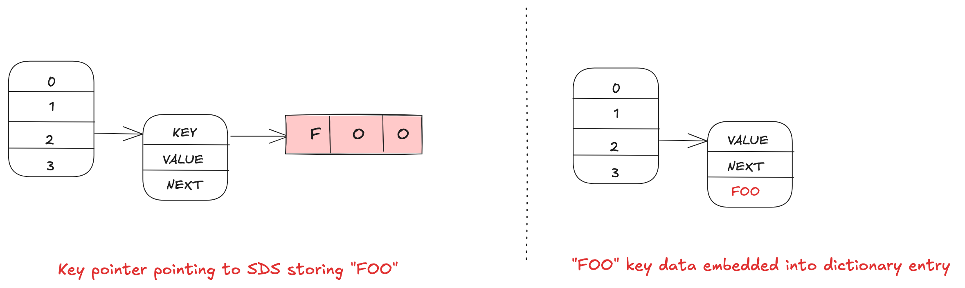
Memory efficiency
Notes:
One big piller was memory efficiency. We noticed there are a lot of pointer chasing in the Valkey implementation of the hash table, the core data structure. We were able to optimize this by embedding data in flexible memory allocations. This can save up to 8 bytes.

Slide 15
Thread scalable command processing
Main Thread
System Epoll
Read Client Command
Parse Command
Execute Command
Send response
Notes:
One big piller was memory efficiency. We noticed there are a lot of pointer chasing in the Valkey implementation of the hash table, the core data structure. We were able to optimize this by embedding data in flexible memory allocations. This can save up to 8 bytes.

Slide 16
Thread scalable command processing
Main Thread
IO Thread 1
System Epoll
Read Client Command
Parse Command
Execute Command
Send response
Notes:
One big piller was memory efficiency. We noticed there are a lot of pointer chasing in the Valkey implementation of the hash table, the core data structure. We were able to optimize this by embedding data in flexible memory allocations. This can save up to 8 bytes.

Slide 17
Thread scalable command processing
Main Thread
IO Thread 1
System Epoll
Read Client Command
Execute Command
Parse Command
Execute Command
Send response
Read Client Command
Read Client Command
Parse Command
Parse Command
Send response
Send response
Notes:
One big piller was memory efficiency. We noticed there are a lot of pointer chasing in the Valkey implementation of the hash table, the core data structure. We were able to optimize this by embedding data in flexible memory allocations. This can save up to 8 bytes.

Slide 18
Thread scalable command processing
Main Thread
IO Thread 1
IO Thread 2
System Epoll
Read Client Command
Execute Command
Parse Command
Execute Command
Send response
Read Client Command
Read Client Command
Parse Command
Parse Command
Send response
Send response
Notes:
One big piller was memory efficiency. We noticed there are a lot of pointer chasing in the Valkey implementation of the hash table, the core data structure. We were able to optimize this by embedding data in flexible memory allocations. This can save up to 8 bytes.

Slide 19
Thread scalable command processing
Main Thread
IO Thread 1
IO Thread 2
Execute Command
System Epoll
Read Client Command
Execute Command
Read Client Command
Parse Command
Execute Command
Parse Command
Send response
Execute Command
Send response
Read Client Command
Execute Command
Read Client Command
Parse Command
Execute Command
Parse Command
Send response
Notes:
One big piller was memory efficiency. We noticed there are a lot of pointer chasing in the Valkey implementation of the hash table, the core data structure. We were able to optimize this by embedding data in flexible memory allocations. This can save up to 8 bytes.

Slide 20
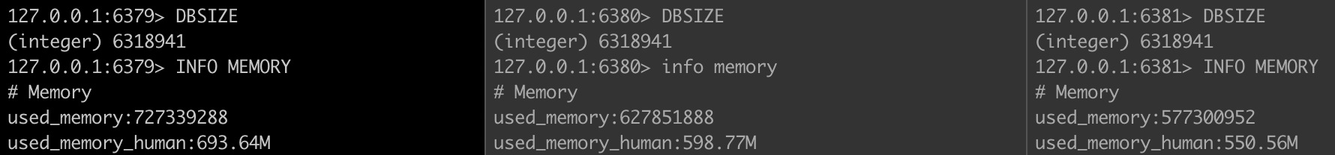
Memory efficiency
Valkey 7.2
16 byte values
16 byte keys
Baseline
Per-slot dictionary
16 byte values
16 byte keys
13.7% memory reduction
+ Key Embedding
16 byte values
16 byte keys
20.1% memory reduction
Notes:
Now 8 bytes might not seem like a lot, but a lot of caching workloads have relatively small keys and values. We benchmarked one customer who used on average 16 byte keys and values, and they saw over a 20% reduction in memory usage when they moved from Valkey 7.2 (which is a fork of Redis 7.2) and Valkey 8.0.

Slide 21
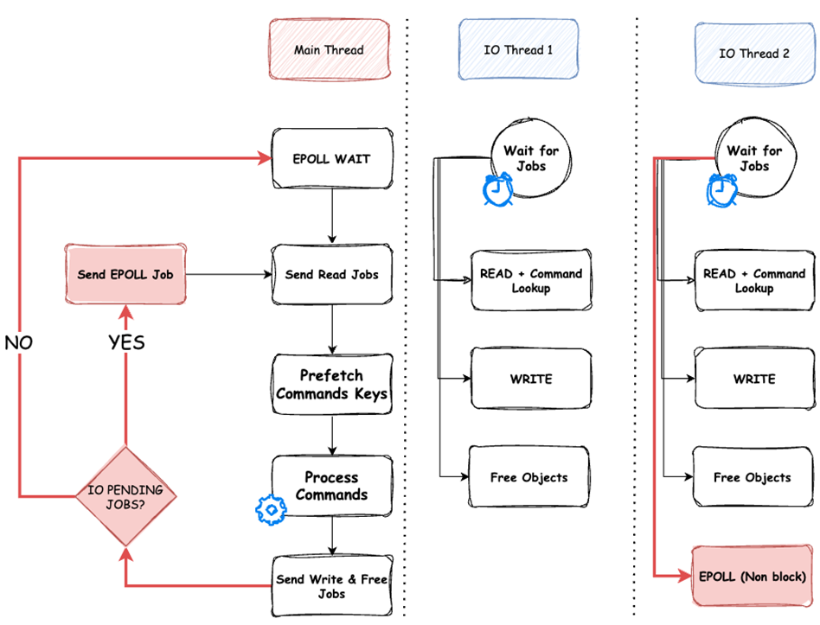
Multithreaded performance
Notes:
We also introduced a new asynchronous threaded IO implementation. In early versions of the engine, the system would switch between I/O phases and command execution phases. No longer. Now the main thread is able to execute commands while secondary threads are purely responsible for network I/O. This new architecture also allowed us to start batching up commands more efficiently and prefetching memory for DRAM in to CPU caches. So what was the result?

Slide 22
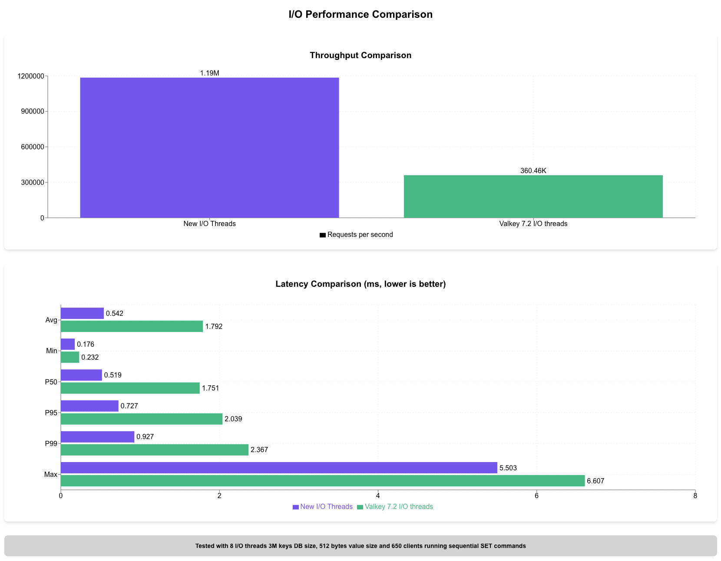
Multithreaded performance
Notes:
A 3x overall improvement in throughput compared to the previous version at similar or better latencies. This is a great way to better utilize multi-core machines in order to minimize the latency of your application.

Slide 23
Valkey 8.1
Notes:
Now there is a lot of other exciting features in Valkey 8.0, but that release is old news now. So let’s talk about our most recent launch, Valkey 8.1.

Slide 24
A new hash table
Table Array
000
001
010
011
100
101
110
…
Dictionary
Metadata
Table[0]
Table[1]
“FOO”
Dict Entry
Key
Value
Next
“BAR”
Valkey Object
Dict Entry
Metadata
Value
Key
Value
Next
Notes:
After the memory and performance learnings of our previous release, we released there was a much bigger opportunity. So we decided to take a gamble, and try to completely modernize the main dictionary. We took inspiration from the Google designed “Swiss Table”. The main innovation is that instead of having a linked list of items that have a hash collision (where the hash function generates the same number for two different entries) we store them in a larger bucket. This allows us to simplify the design and save up to 16 bytes by removing the container object as well as the next pointers. It’s also a bit faster, but let’s focus on the memory savings.

Slide 25
A new hash table
Table Array
000
001
010
011
100
101
110
…
Dictionary
Metadata
Table[0]
Table[1]
Dict Entry
“FOO”
Value
Next
“BAR”
Valkey Object
Dict Entry
Metadata
Value
Key
Value
Next
Notes:
After the memory and performance learnings of our previous release, we released there was a much bigger opportunity. So we decided to take a gamble, and try to completely modernize the main dictionary. We took inspiration from the Google designed “Swiss Table”. The main innovation is that instead of having a linked list of items that have a hash collision (where the hash function generates the same number for two different entries) we store them in a larger bucket. This allows us to simplify the design and save up to 16 bytes by removing the container object as well as the next pointers. It’s also a bit faster, but let’s focus on the memory savings.

Slide 26
A new hash table
Table Array
000
001
010
011
100
101
110
…
Dictionary
Metadata
Table[0]
Table[1]
Dict Entry
“FOO”
Metadata
“BAR”
Next
Dict Entry
Key
Metadata
…
Notes:
After the memory and performance learnings of our previous release, we released there was a much bigger opportunity. So we decided to take a gamble, and try to completely modernize the main dictionary. We took inspiration from the Google designed “Swiss Table”. The main innovation is that instead of having a linked list of items that have a hash collision (where the hash function generates the same number for two different entries) we store them in a larger bucket. This allows us to simplify the design and save up to 16 bytes by removing the container object as well as the next pointers. It’s also a bit faster, but let’s focus on the memory savings.

Slide 27
A new hash table
Table Array
000
001
010
011
100
101
110
…
Dictionary
Metadata
Table[0]
Table[1]
Dict Entry
Dict Entry
“FOO”
Metadata
“BAR”
Next
Key
Metadata
…
Notes:
After the memory and performance learnings of our previous release, we released there was a much bigger opportunity. So we decided to take a gamble, and try to completely modernize the main dictionary. We took inspiration from the Google designed “Swiss Table”. The main innovation is that instead of having a linked list of items that have a hash collision (where the hash function generates the same number for two different entries) we store them in a larger bucket. This allows us to simplify the design and save up to 16 bytes by removing the container object as well as the next pointers. It’s also a bit faster, but let’s focus on the memory savings.

Slide 28
A new hash table
Table Array
Bucket 000
Bucket 001
0
1
2
3
4
5
6
0
1
2
3
4
5
6
Dictionary
Metadata
Table[0]
Table[1]
Dict Entry
Dict Entry
“FOO”
Metadata
“BAR”
“HELLO”
Metadata
“”
Notes:
After the memory and performance learnings of our previous release, we released there was a much bigger opportunity. So we decided to take a gamble, and try to completely modernize the main dictionary. We took inspiration from the Google designed “Swiss Table”. The main innovation is that instead of having a linked list of items that have a hash collision (where the hash function generates the same number for two different entries) we store them in a larger bucket. This allows us to simplify the design and save up to 16 bytes by removing the container object as well as the next pointers. It’s also a bit faster, but let’s focus on the memory savings.

Slide 29
A new hash table
Table Array
Bucket 000
Bucket 001
0
1
2
3
4
5
6
X
0
1
2
3
4
5
6
X
Dictionary
Metadata
Table[0]
Table[1]
Dict Entry
Dict Entry
“FOO”
Metadata
“BAR”
“HELLO”
Metadata
“”
Bucket 000 (cont)
0
1
2
3
4
5
6
X
Notes:
After the memory and performance learnings of our previous release, we released there was a much bigger opportunity. So we decided to take a gamble, and try to completely modernize the main dictionary. We took inspiration from the Google designed “Swiss Table”. The main innovation is that instead of having a linked list of items that have a hash collision (where the hash function generates the same number for two different entries) we store them in a larger bucket. This allows us to simplify the design and save up to 16 bytes by removing the container object as well as the next pointers. It’s also a bit faster, but let’s focus on the memory savings.

Slide 30
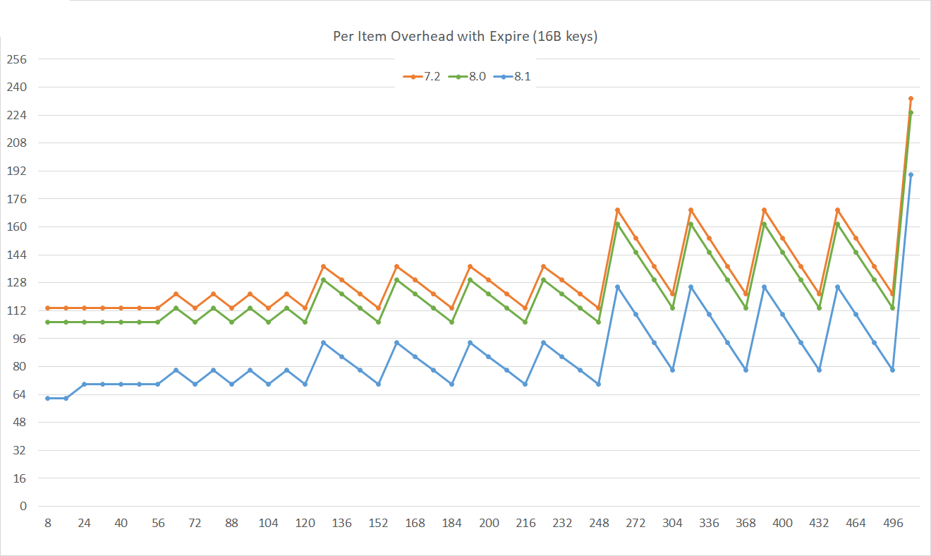
A new hash table
Notes:
These lines compare the actual memory usage between 8.1, 8.0, and 7.2. You can see that 8 byte drop we talked about earlier, compared to up to 32 bytes you can see when using expires. (We have two hash tables, one for the expiration information and one for the actual data). In the real world you won’t see this big of an improvement, but it’s a big improvement for some workloads.

Slide 31
Valkey 8.1 features
Performance
New key/value store that reduces memory overhead by 20% and improves most workloads
Improved full-sync time with prefetching iterator and using an optimized checksum
Up to 300% improved performance by offloading TLS negotiations
Improved sorted set operations with new floating point library
New memory defragmentation algorithm which reduced P100 latency by up to 90%
Observability
New commands for detecting commands with large replies
Increased the number of events covered under the latency monitor
New functionality
Conditional updates built into the SET command
Notes:
Some other assorted improvements. Talk about these if you want.

Slide 32
What's next
Release cadence: major version yearly, minor versions as needed
Valkey 10.0 — expected Q4 2026
  Secondary index and full-text search
  Continued IO threading and performance improvements
  Extended module ecosystem
Valkey 9.0 maintenance support through October 2028
Valkey 8.1 security support through March 2030
Source: valkey.io/topics/releases/ • valkey.io/blog/2025-year-end/

Slide 33
Features under active development
Reliability
  Improved cluster stability and automatic failover
  Enhanced observability and introspection tooling
New functionality
  Secondary index and full-text search
  Extended module ecosystem (JSON, Bloom, Vector Search)
  Continued IO threading improvements
Notes:
Many of the features previously listed here have shipped in Valkey 9.0 and 9.1.
Atomic slot migration, hash field expiration, and numbered databases in cluster mode all shipped in 9.0.
Large cluster improvements (2k nodes, 1B RPS) also shipped in 9.0.
The community is now focused on search capabilities, extended module support, and continued performance work.

Slide 34
Integrations

Slide 35



Valkey module distribution
Search
(Vector similarity and Full-text)
JSON
Bloom Filter
Notes:
This release also included 3 new modules, JSON, bloom, and Vector similar search.

Slide 36
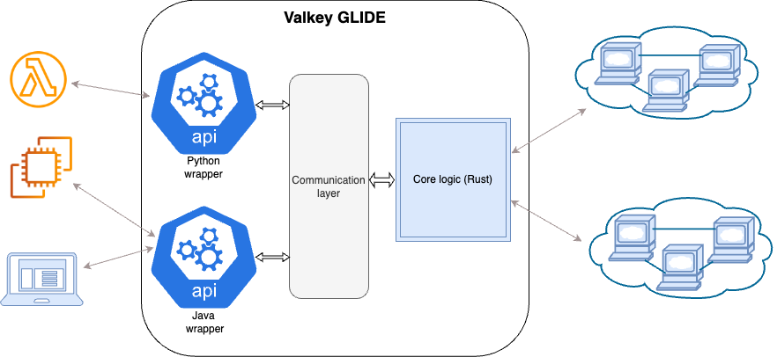
Valkey Glide
THE HIGH PERFORMANCE MULTI-LANGUAGE CLIENT FOR VALKEY

Slide 37


Get involved in the project
valkey.io
valkey/valkey
github.com/valkey-io
Notes:
We’d love you to come joint he project.

Slide 38
Migrations
Notes:
Earlier on we talked about compatibility. Let’s dive into that.

Slide 39
Migrating from Redis OSS to Valkey
redis/redis:7.2
valkey-io/valkey
Re-brand
Config
Same
Config
API and commands
Same
API and commands
RESP protocol
Same
RESP protocol
Client libraries
Same
Client libraries
Notes:
Valkey is API, configuration, protocol, and client library compatibility. You won’t necessarily be able to take advantage of some of the new functionality, but it will be compatible.

Slide 40
Strategies for migration
LRU
Rolling updates
Backup and restore
Third party tooling
Notes:
There are a few ways to migrate.
1. If you are using Valkey as a cache, you can simply doing a rolling update with new hosts pointing to the new cache. On cache misses, your data will get rehydrated into the new Valkey cluster.
2. You can also take a backup of your Redis cluster, and restore it into Valkey. Redis snapshots taken on version 7.2 and earlier are compatible, but older versions are not compatible. There is a new configuration in Valkey 8.1 that allows you to try to load a new Redis snapshot, but it might fail if it finds some incompatible data.
3. Lastly, there are third party tools like RIOT that allow for online migration between two completely different Redis compatible systems.

